Slide 1

Bank Analysis Project - Group 6
Nadeem
Maya
Vashvi
Sakshi

Slide 2
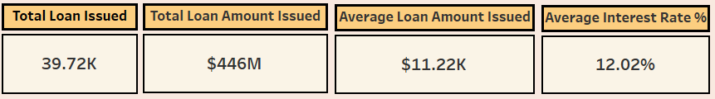
Insight gain from visuals
Key Metrics
Total Loan Issued (39.72K): This metric shows how many loans the bank has given. This means the bank is giving loans to many customers and is actively lending.
Total Loan Amount Issued ($446M): This metric shows the total amount of money the bank has lend, giving an idea of how big the bank's loan business is.
Average Loan Amount Issued ($11.22K): This metric shows the average loan amount, indicating how much money people usually borrow from the bank.
Average Interest Rate (12.02%): This shows the average interest rate that the bank charges on loans.

Slide 3
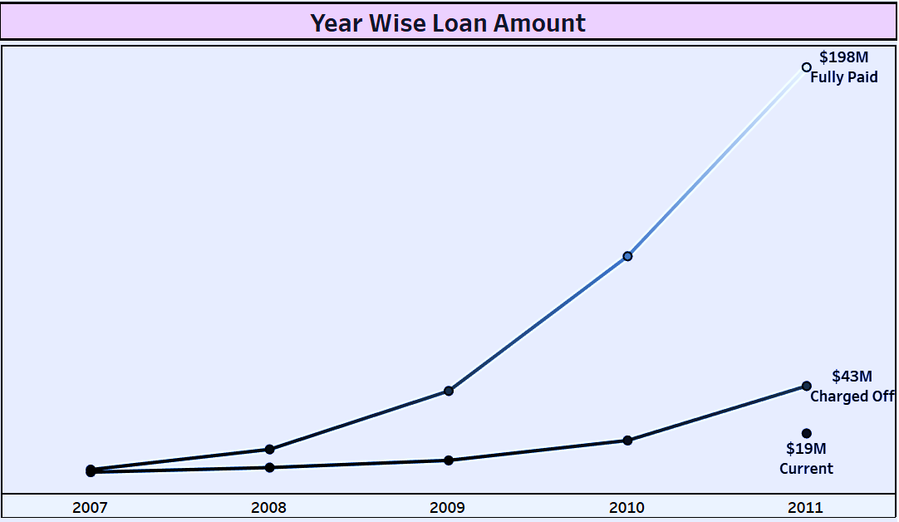
Year Wise Loan Amount
This illustrates how the loan statuses of customers have changed over different years.
It categorizes loans into various statuses such “Fully Paid,” “Charged Off,” and “Current,”
Fully Paid i.e. $198M which means borrower has completed all the payments.
Charged off i.e. $43M which reflects negative impact on the bank profitability & can affect its overall financial health
Current i.e. $19M appeared only in the year 2011 indicates the up - to - date regular payments

Slide 4
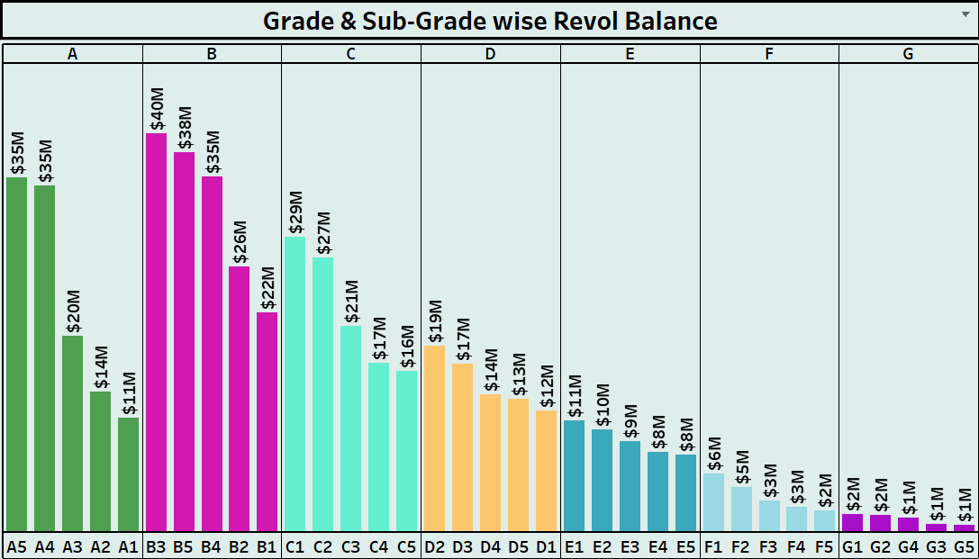
Grade & Sub-Grade wise Revolving Balance
The graph is designed to illustrate the relationship between different loan grades and their corresponding sub-grades with respect to the revolving balance.
Each grade represents a category of loans that have been assigned based on creditworthiness, risk factors, and other financial metrics.
Each grade represents a category of loans that have been assigned based on creditworthiness, risk factors, and other financial metrics.
Its quick visualization which indicates the grades and sub-grades hold higher or lower revolving balances

Slide 5
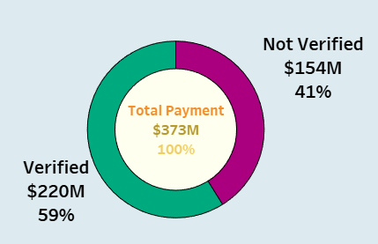
Verified Vs Non Verified Payment Status
The above distribution illustrate the status of verified and non-verified accounts.
Verified payments typically indicate that a transaction has undergone a thorough verification process, which may include checks like account ownership confirmation and fraud detection algorithms.
Non-verified payments often lack these security measures, making them more susceptible to fraudulent activities.

Slide 6
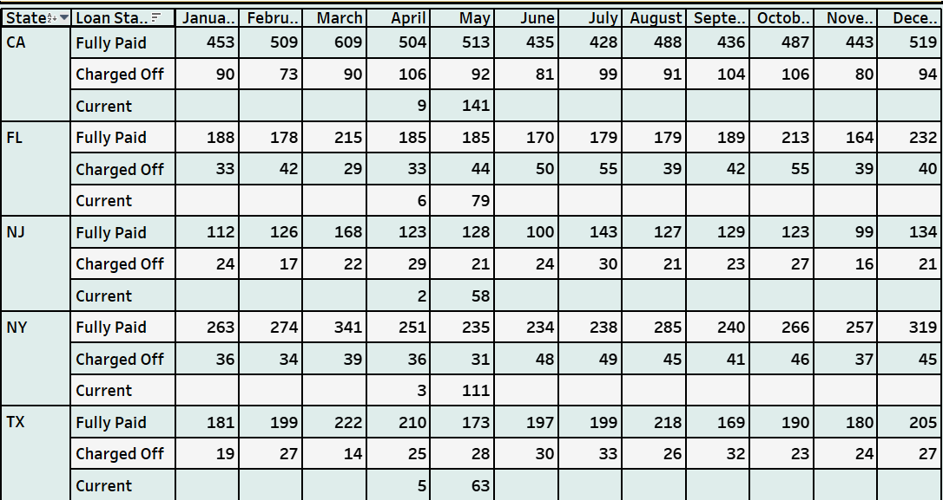
State & month wise loan status
The above table reflects the insights into how loan statuses vary across different states and over specific months.
It examines how many loans fall into various statuses (e.g., Fully Paid, Charged Off, Current) within each state.
It helps stakeholders identify trends, patterns, and potential issues related to loan performance in various geographical locations and time periods.

Slide 7
Home Ownership Vs Last Payment Date
This metric refers to whether an individual owns their home or rents it.
It shows the percentage of total Loan amount issued to each category
It provides the insights into how much each group typically borrows.

Slide 8

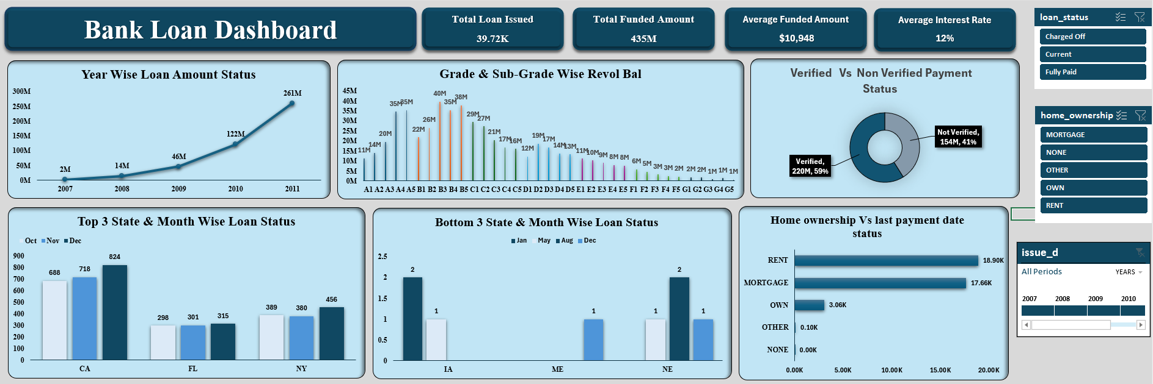
Excel Dashboard

Slide 9

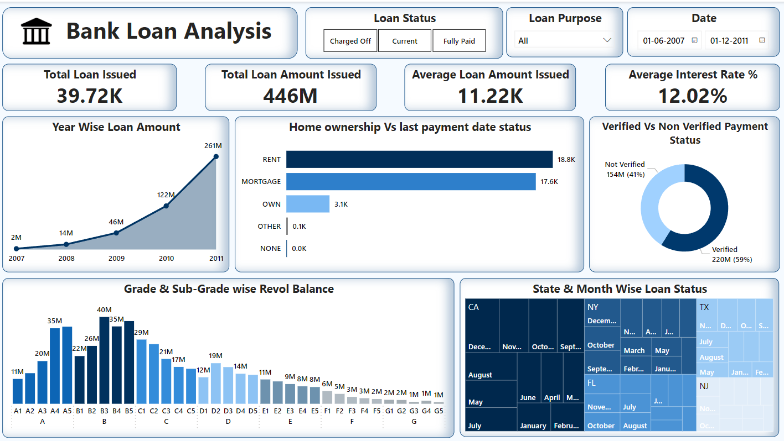
Power Bi Dashboard

Slide 10

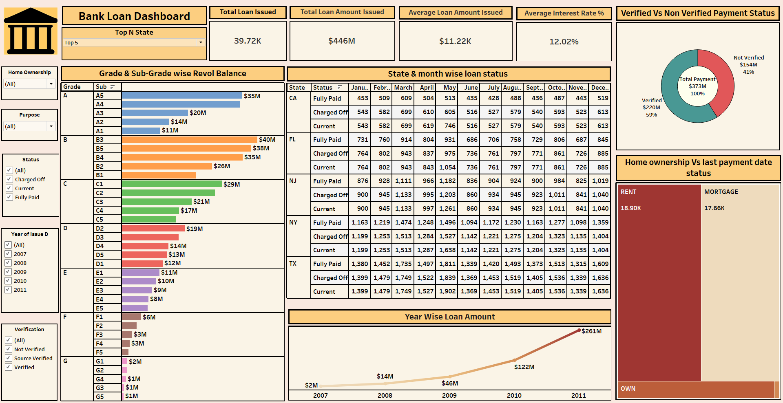
Tableau Dashboard

Slide 11

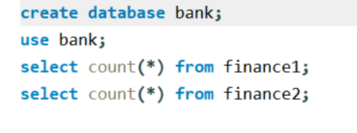
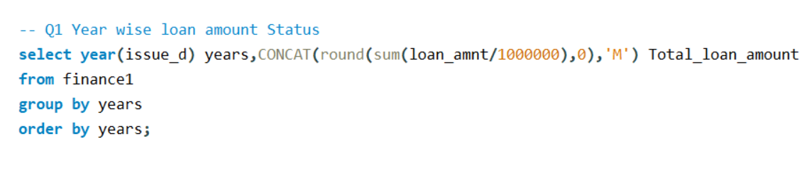
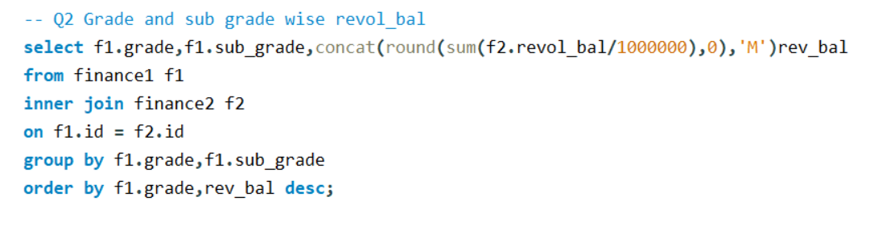
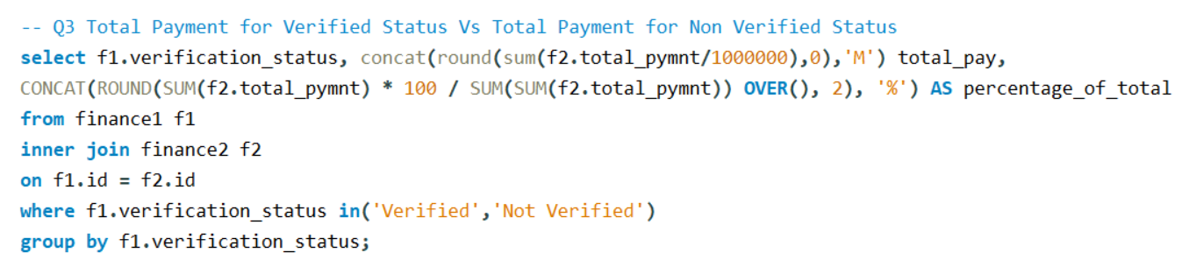
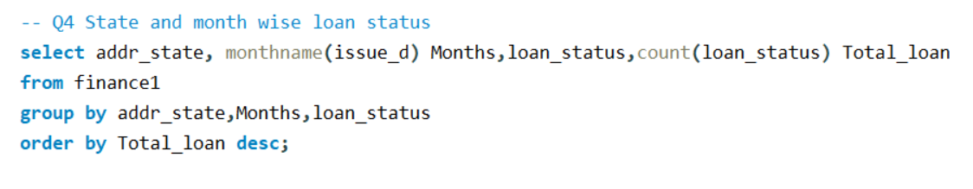
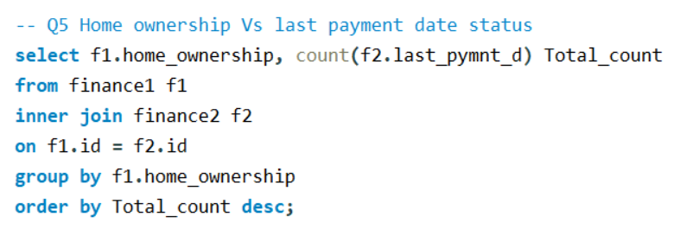
SQL Queries

